Slide 1



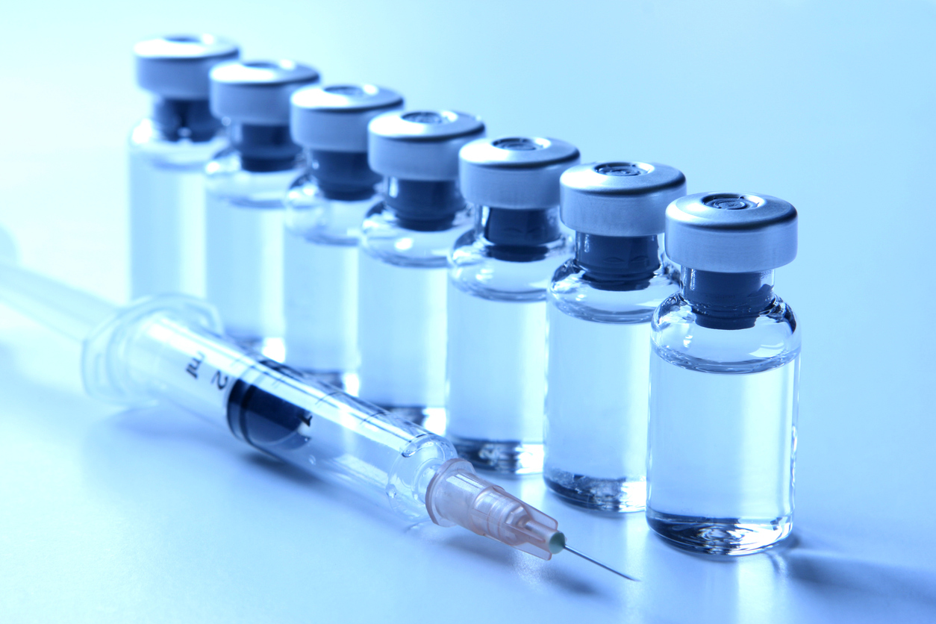
Niraj KC

Slide 2
Target audiences
HEALTHCARE WORKERS
-Health care workers interacts with families and patients

Slide 3
The goal and objective of vaccine safety communications
Communicating about vaccine safety is always important. It is essential in at least the following situations:
explaining properly the benefits and risks of a recommended vaccine.
addressing public concerns and upcoming or persistent rumors about vaccine safety.
preparing to address vaccine safety crises if and when they occur.
The goal of vaccine safety communication is to make people aware of vaccines and to make their maximum participation in the vaccinations which will ultimately make them free from vaccine-preventable diseases.

Slide 4
Health care workers
Healthcare workers include
-doctors,
nurses,
dentists,
medical students,
pharmacists, etc.

Slide 5
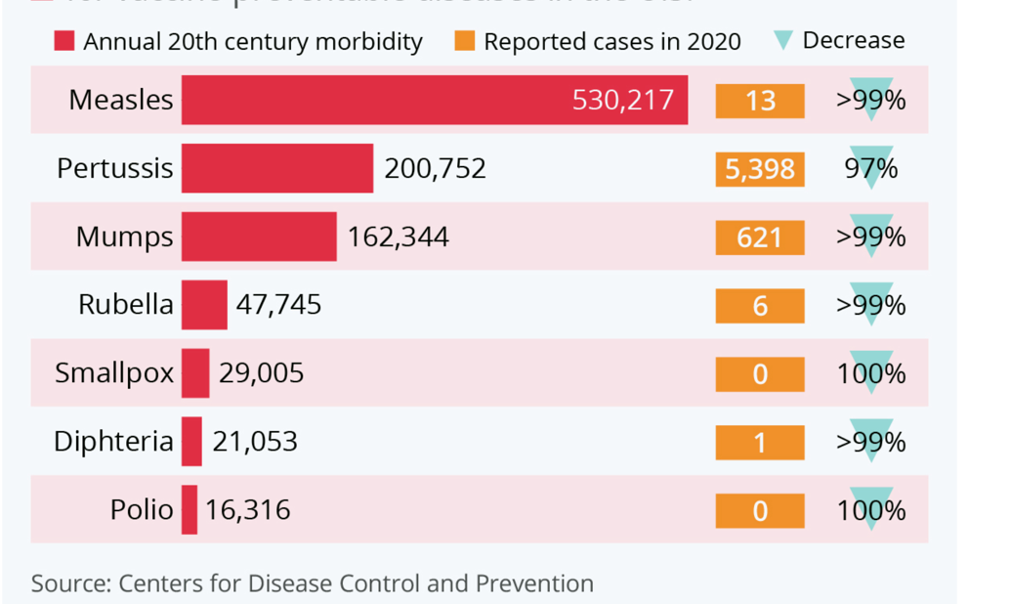
How effective vaccines have been against major diseases in America
Vaccines prevent diseases.
Healthcare workers should educate patients.
Source: Center for Disease control and prevention

Slide 6
Healthcare workers’ roles
Healthcare workers work in fields:
Deals with patients.
Should educate patients/lay public about the importance of vaccines.
Should notice the adverse events of vaccines.
Should play a vital role in public health.
Healthcare professionals should have adequate knowledge about vaccines, their adverse events, and their benefits.

Slide 7
Importance of vaccines safety
Produce antibodies against harmful diseases.
Universally accepted for controlling the disease.
Minor reactions VS Overall Protections.
Decrease in pandemics like polio, covid19, etc., due to vaccines.
Helps control community spread of pandemics.

Slide 8
Clinical assessment of vaccine safety pre-licensure
Process of the first stage in assessing vaccine safety, Phase I, before introducing adverse events (AEs) are-
The first studies were conducted on Animals.
Then clinical trials in humans begin.
The new vaccine is administered to healthy volunteers for the first time
All adverse events are collected and assessed as to whether they are deemed to be related to the vaccine or not.
Later tested in thousands before being allowed into the market.

Slide 9
Safety assessment post-licensure
Identify rare or novel adverse event
Estimate their rate of occurrence
Distinguish those that are causally related to vaccination
Identify vaccines lots with adverse events.
Monitors regularly.

Slide 10
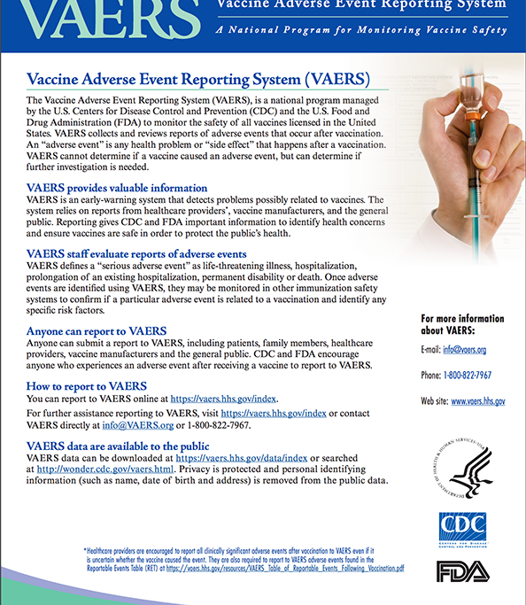
What is VAERS?
VAERS provides valuable information
VAERS evaluates adverse events
Anyone report to VAERS
VAERS data available to public

Slide 11
Objectives of VAERS
Detect
Detect new, unusual, or rare vaccine adverse events;
Monitor
Monitor increases in known adverse events;
Identify
Identify potential patient risk factors for particular types of adverse events;
Assess
Assess the safety of newly licensed vaccines;
Determine and address
Determine and address possible reporting clusters (e.g., suspected localized [temporally or geographically] or product-/batch-/lot-specific adverse event reporting);
Recognize
Recognize persistent safe-use problems and administration errors;
Provide
Provide a national safety monitoring system that extends to the entire general population for response to public health emergencies, such as a large-scale pandemic influenza vaccination program.

Slide 12
Communication strategies to boost vaccine acceptance by NIPs(NATIONAL IMMUNIZATION PROGRAM)
Encouraging people to report adverse events.
Identify adverse events or rumors in the media.
Temporary suspensions of vaccines.
Research about adverse events causing vaccines
Vaccines recall
Replacement of vaccines if needed.

Slide 13
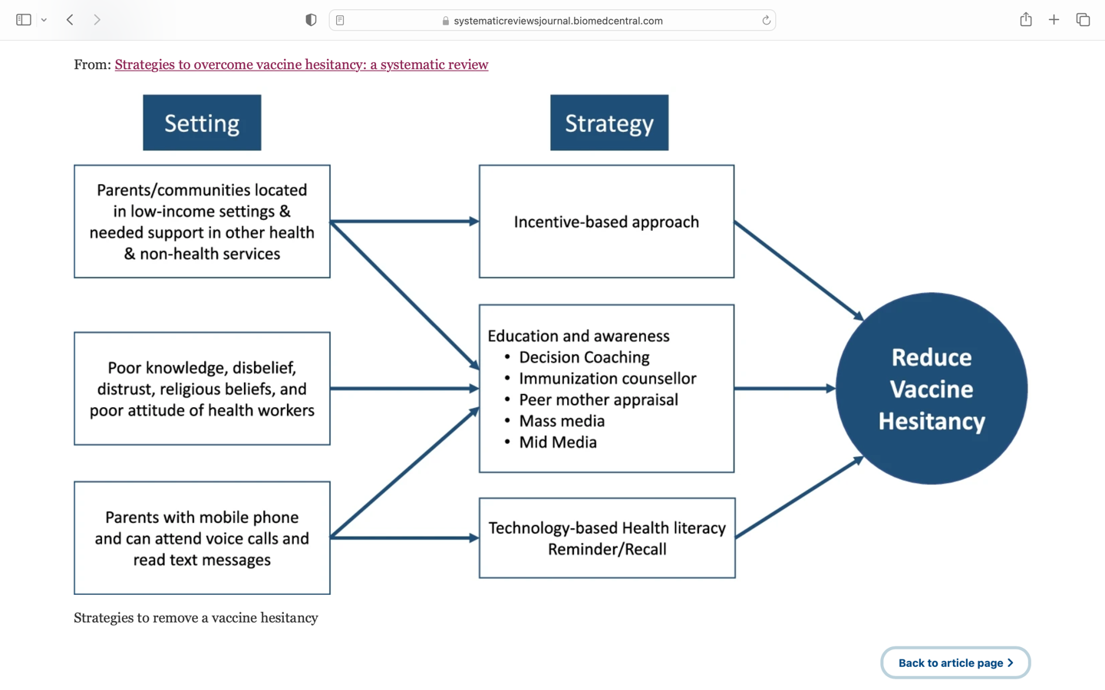
Best Practices to Overcome Vaccine Hesitancy
(Source: https://systematicreviewsjournal.biomedcentral.com/articles/10.1186/s13643-022-01941-4/figures/2)

Slide 14
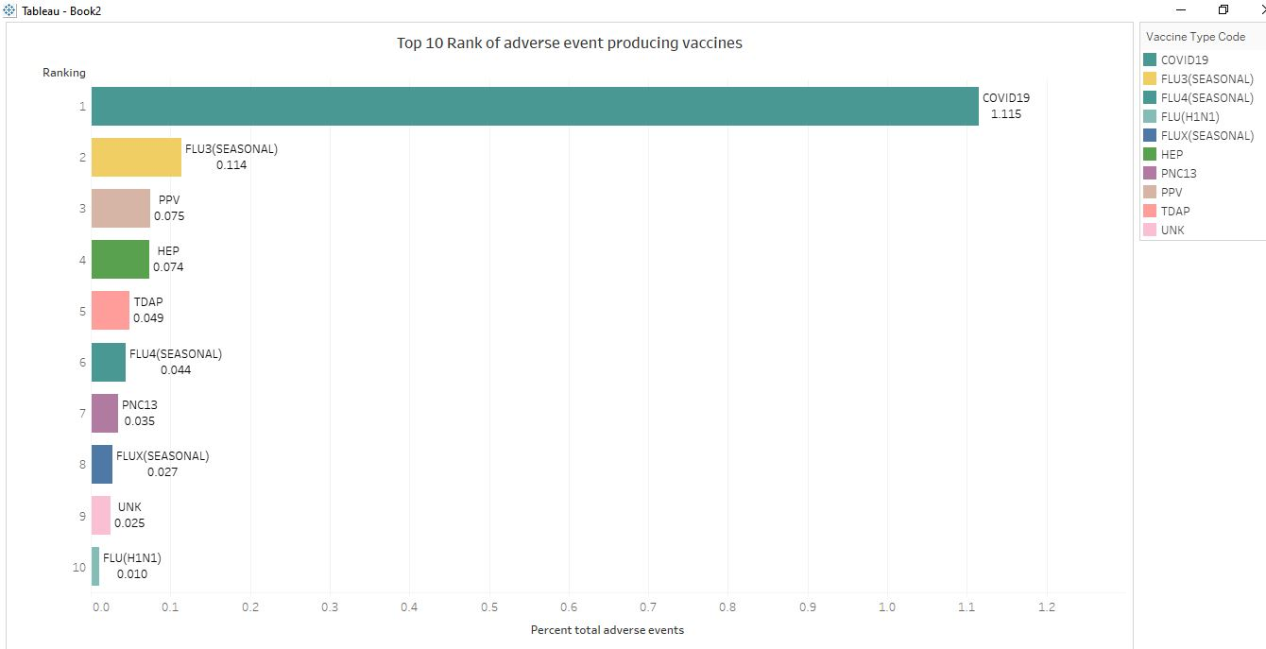
Top adverse event-producing vaccines
Source of data: http://wonders.cdc.gov/vaers.html

Slide 15
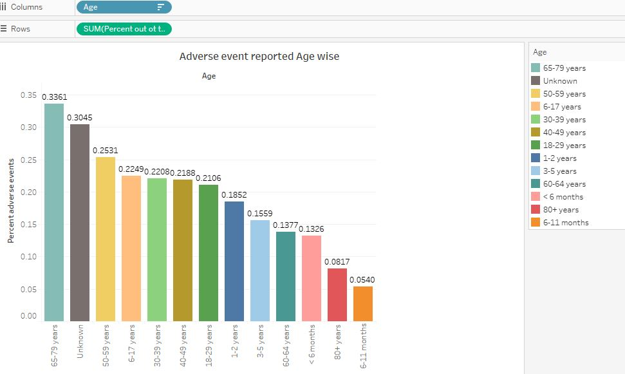
Adverse events reported age wise
source of data: CDC website: http://wonders.cdc.gov/vaers.html

Slide 16
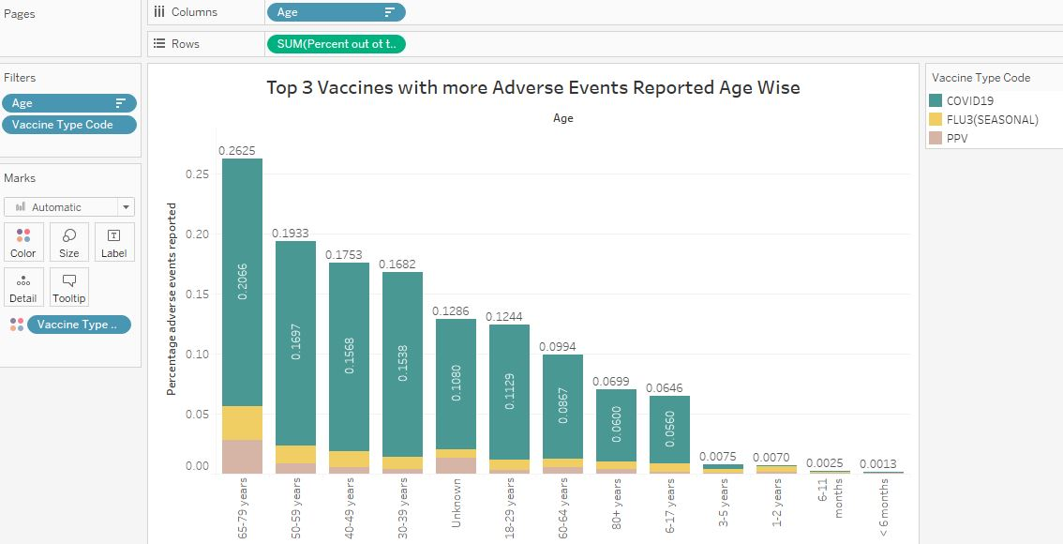
Top 3 vaccines with adverse events age wise

Slide 17
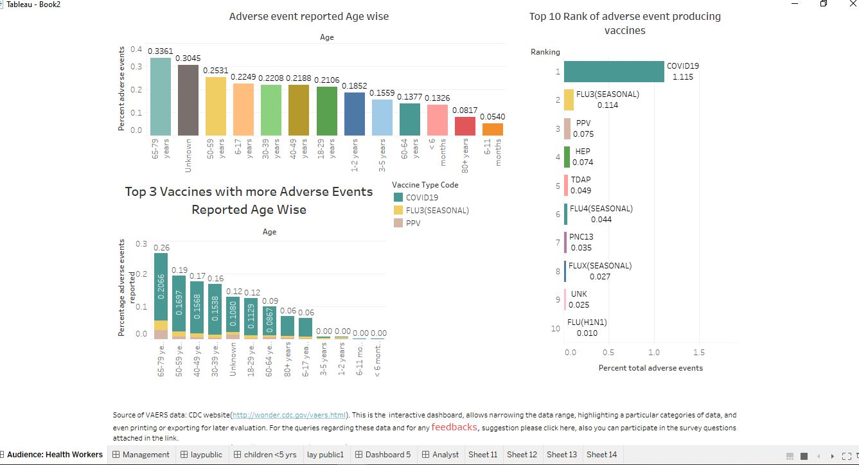
Interactive dashboard for the healthcare workers source of data: CDC website: http://wonders.cdc.gov/vaers.html Interactive Feedback sections from healthcare workers at the bottom of the dashboard.

Slide 18

Target audiences
Lay public:
less sophisticated audiences
less knowledge, education
less aware about vaccines and their child health care.
CHILDREN:

Slide 19
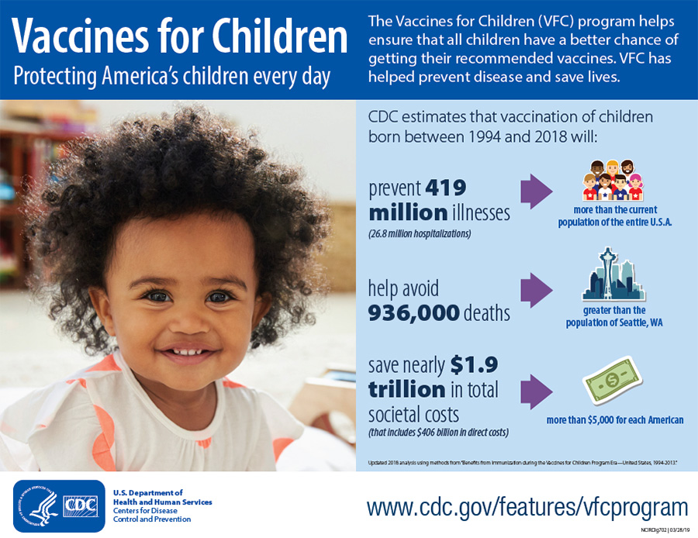
Vaccines for children
Saves millions of children’s life between 1994 to 2018.

Slide 20
Five important reasons to vaccinate your child
Immunizations can save your child's life.
Vaccination is very safe and effective, adverse events are very less in total.
Immunization protects others you care about.
Immunizations can save your family time and money
Immunization protects future generations.

Slide 21
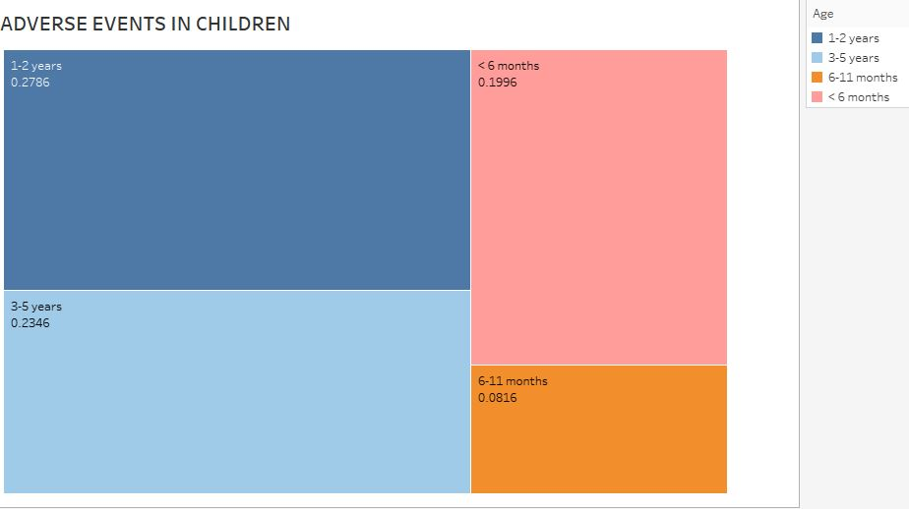
Immunizing children is safe While analyzing VAERS data from CDC collected on Sept 12, 2022, the odds of getting adverse events is only 0.08% in children less than 1 year age children. Parents should be confident to immunize their children by seeing data.
Source of data: CDC website: http://wonders.cdc.gov/vaers.html

Slide 22
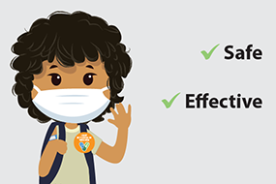
Fact of vaccines
EFFECTIVE
SAFE
NECESSARY
RESULTS OF INTENSIVE TRIALS AND STUDIES.

Slide 23
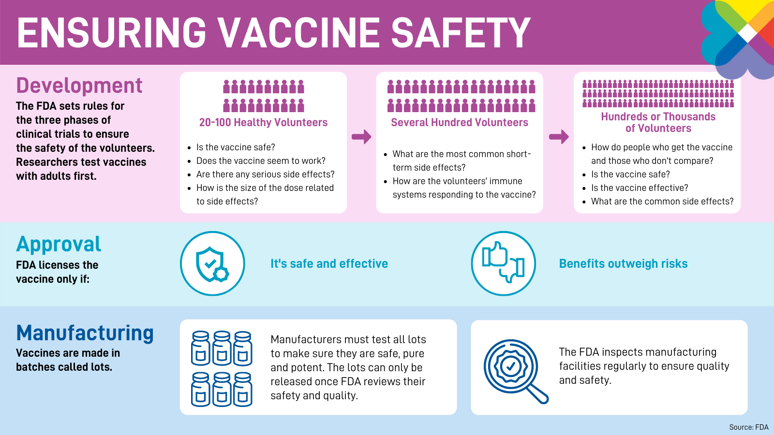
Method employed to make vaccines safe

Slide 24
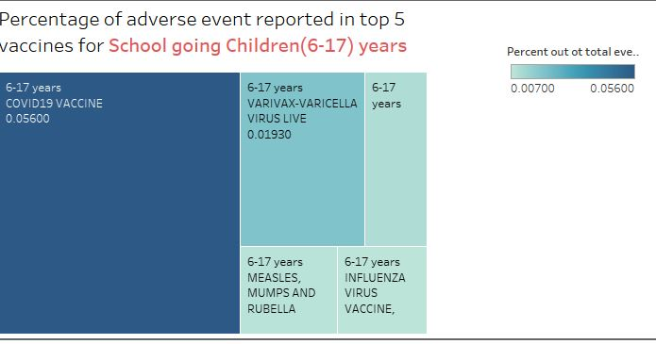
Vaccines ensure healthy life for school-going children
For school-going children also adverse events in very low.
Covid 19 has the highest number of adverse events, but that is also too low 0.05%. From VAERS data collected on Sept 12th, 2022, vaccines are safe for school-going children, people should have no doubt in mind while immunizing children. Vaccines save a life.
source of data: CDC website from 12th sept 2022: http://wonders.cdc.gov/vaers.html

Slide 25
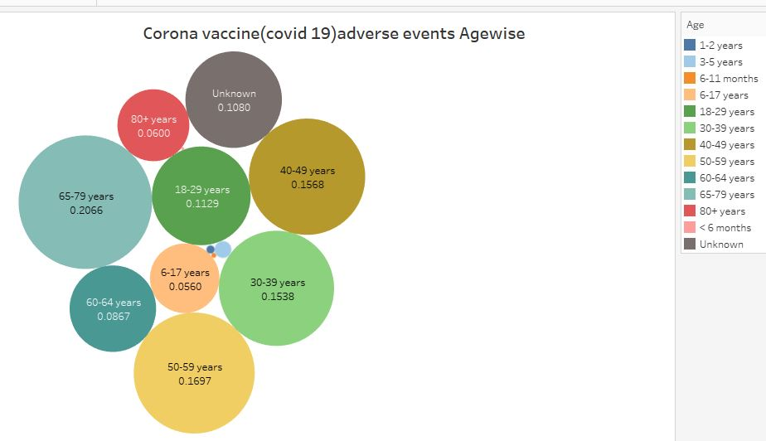
Its time to make decision?
Data speaks.
source of data: CDC website from 12th sept 2022: http://wonders.cdc.gov/vaers.html
The adverse event is very low in all age groups.
Quite interestingly adverse events in much lower for children.

Slide 26
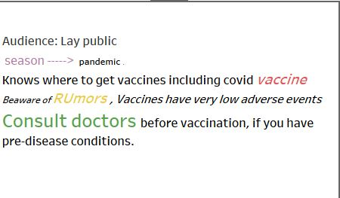
Wants to move towards healthy life ?

Slide 27
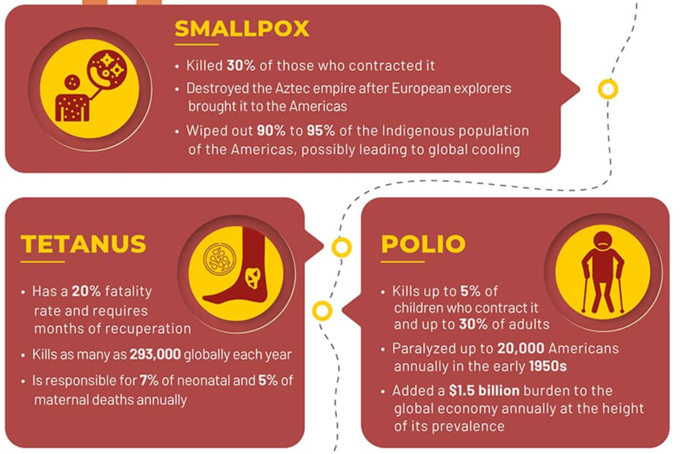
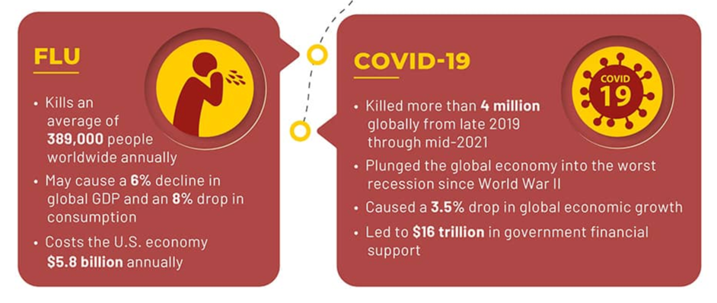
Important vaccines in the history

Slide 28

Why Vaccinate?
Vaccines are tested to ensure that they are safe and effective for children to receive at the recommended ages.
provide immunity before children are exposed to potentially life-threatening diseases.
Without vaccines, your child is at risk for serious illness or even death from diseases like measles and whooping cough.
The United States had more than 1,200 cases of measles in 2019. This was the greatest number of cases reported in the U.S. since 1992 and since measles was declared eliminated in 2000.
vaccines protect against 14 diseases by age two.
The MMRV vaccine combines the MMR (for measles, mumps, and rubella) vaccine with the chickenpox vaccine, really effective, with one shot protects from different disease.
(Source:https://www.cdc.gov/vaccines/schedules/easy-to-read/child-easyread.html)

Slide 29
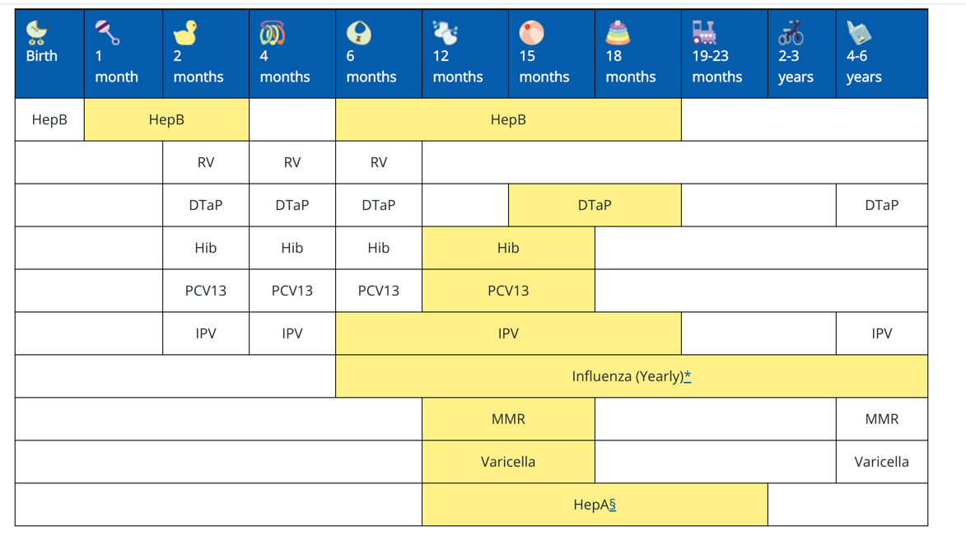
Recommended vaccinations for infants and children source: https://www.cdc.gov/vaccines/schedules

Slide 30
Types of audience
Management
Management:
Policymakers
Hospital managers oversee the general administration of hospitals and other provider facilities.
Their central goals are to prioritize patient safety, as well as to ensure the financial and operational sustainability of the sites they manage.

Slide 31
Vaccination policy for healthcare workers
Management team policies help healthcare workers understand the importance of vaccines.
Healthcare workers include all the staffs that work in hospital-physicians, nurses, laboratory technicians, medical students, etc.
The policy includes seminars and training courses for these staff to make them understand vaccines.
The policy also includes free vaccinations for their staff and patients by consulting with the stakeholders.

Slide 32
Managers role for policy making
For making policies Management team should understand the vaccines statistics of the country. For this presentation with clear and simple visuals help manger to understand. So policy makers can consult with the city, state, and governmental to do necessary steps for better vaccines policies.
Policy makers should make policy to sustain their hospital . Also, they need to take care of the community health too by providing free services, talking low cost in vaccines and for the services they provide.

Slide 33
Objectives:
To make makers better understand the vaccine statistics so that they can make better policies.
Make them understand the importance of vaccines and poor vaccination rates.
Help them to make decisions on how to make vaccines free for the lay public, and their staff.
To make them better aware of the vaccination situations and its effectiveness
To make them realize, what they can do to increase the overall health of people from vaccinations.

Slide 34
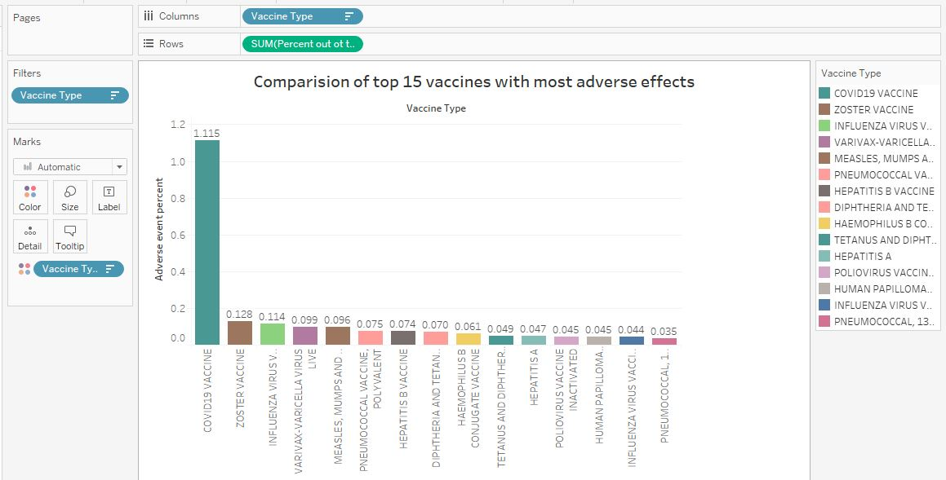
Hospital management policy Objectives: . to allocate the budget to study which vaccines produce adverse effect . to notify the local government about the adverse events of vaccines .to educate health staff about the importance of vaccines to safe lives .to make plans to sustain the hospital and maximize the profit by selling the vaccines. .to train the staff professionally which will help to increase customers(patients).
High incidence rate in covid vaccines (1.115%), this is because lots of people get covid 19 vaccines during pandemic.
Adverse events on other vaccines is low
source of data: CDC website: http://wonders.cdc.gov/vaers.html

Slide 35
In the USA alone, 98,777,220 people get infected with coronavirus, and a total of 1,077,303 people died until 7 Dec 2022.
Corona virus is highly contagious and easily spread within the community through air, food, and water.
Covid 19 vaccines save millions of lives in the USA and around the whole world.
In a study conducted in The Lancet Infectious Diseases, it is estimated that covid vaccines save around 19.8 million lives in one year.
Source: CDC | Data as of December 7, 2022

Slide 36
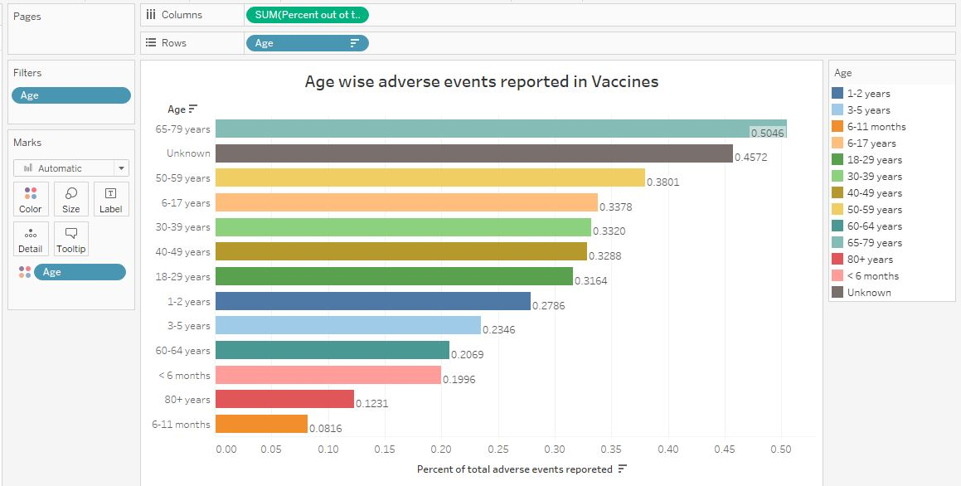
Age-wise adverse events in vaccines .The top two of the adverse events age groups are older age groups. .Policymakers should focus on providing free medicines to these age groups while vaccinating them, and for this managers should incorporate with the governments and health insurance companies for providing free medicines so that adverse events could be reduced.
source of data: CDC website: http://wonders.cdc.gov/vaers.html

Slide 37
Policy for immunization of health-care workers
Vaccine recommendation programs can assist hospital administrators, infection control practitioners, employee health physicians, and HCWs in optimizing infection prevention and control programs. Background information for each vaccine-preventable disease and specific recommendations for use of each vaccine should be presented to them.
Because of their contact with patients or infective material from patients, many health-care workers (HCWs)(e.g., physicians, nurses, emergency medical personnel, dental professionals and students, medical and nursing students, laboratory technicians, hospital volunteers, and administrative staff) are at risk for exposure to and possible transmission of vaccine-preventable diseases. Maintenance of immunity is therefore an essential part of prevention and infection control programs for HCWs. Optimal use of immunizing agents safeguards the health of workers and protects patients from becoming infected through exposure to infected workers

Slide 38
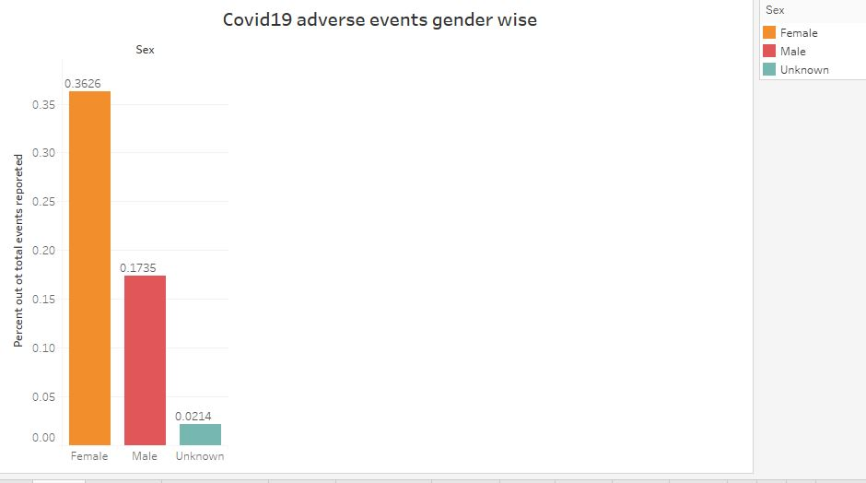
Covid adverse events gender wise The adverse events due to covid vaccines are very low in all genders. 0.36% of cases in females and 0.17% in males report adverse events, due to the fact that a large number of people administrated covid vaccines. So, in total, the cases of adverse events are very low.
source of data: CDC website: http://wonders.cdc.gov/vaers.html

Slide 39
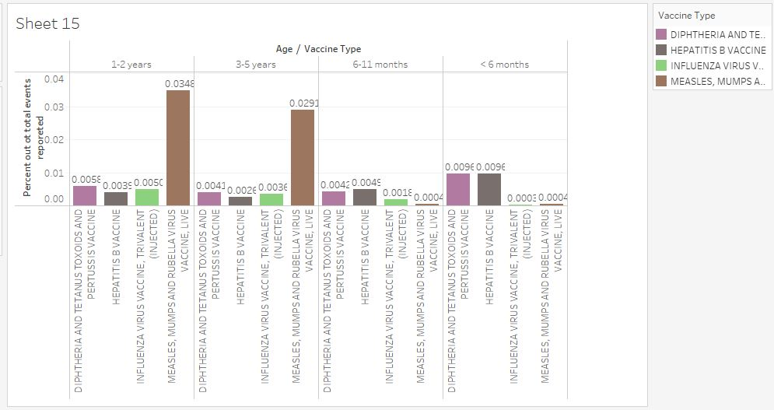
Best age to immunize children

Slide 40
High risk exposure for kids <=5 & general >5 years of age
The top vaccines with the highest adverse events-covid19 were highest with 1.12%, flu3(seasonal) was second with 0.11% and third was PPV with 0.07%. When adverse events were seen age-wise, the Older age group 65-79 years of age have shown the highest incidence followed by the age group 50-59. It is obvious that when age increases, immunity of the body also decreases, so to be safe from different diseases, people may have administrated different vaccines.

Slide 41
continue….
When adverse events were compared in the different age groups of children. The age group 1-2 years shows 0.27% incidence, followed by 0.23% by the age group 3-5 years, whereas the 6-11 month age group shows the least incidence 0.08% as a whole.
For hepatitis B, it was seen that the best age group to immunize children was 3-5 years, and children <6 months had shown the most adverse events.
For MMT vaccines, when administrated from 1-2 years, so adverse events were also showing more for this age group.

Slide 42
continue….
For influenza, the recommended age group for vaccination was 6 months to 6 years of age, with children with 6-11 months showing fewer adverse events, so better to vaccinate at this age period.
For DTaP, the children with <6 months were showing a high incidence rate, so better to omit DTaP vaccination during this period.

Slide 43
Immunization of health-care providers: necessity and public health policies
Health-care providers (HCPs) are at increased risk for exposure to vaccine-preventable diseases (VPDs) in the workplace
Recent studies from several countries indicate significant immunity gaps against many VPDs.
Susceptibility rates of HCPs range from 4.6% to 17% for measles, 15.7% to 25% for mumps, 4.5% to 18.6% for rubella, 4.1% to 16.7% for varicella, 48.3% to 68.8% for pertussis, 22.6% to 35% for hepatitis B, and 21.2% to 64.3% for tetanus and diphtheria
Source:https://www.ncbi.nlm.nih.gov/pmc/articles/PMC5041048/

Slide 44
Types of audience
Analysts

Slide 45
About VAERS data
VAERS data is accessible by downloading raw data in comma-separated value (CSV) files for import into a database, spreadsheet, or text editing program, or by using the CDC WONDER online search tool.
VAERS accepts reports of adverse events that occur following vaccination. Anyone, including Healthcare providers, vaccine manufacturers, and the public can submit reports to the system. While very important in monitoring vaccine safety, VAERS reports alone cannot be used to determine if a vaccine caused or contributed to an adverse event or illness.

Slide 46
continue…
VAERS data are limited to vaccine adverse event reports received between 1990 and the most recent date for which data are available.
The number of reports alone cannot be interpreted as evidence of a causal association between a vaccine and an adverse event, or as evidence about the existence, severity, frequency, or rates of problems associated with vaccines.
Adverse events reported in the VAERS data do not necessarily be the casuality associated with the vaccines.

Slide 47
Presentation slides consists of following features:
Percentage of adverse events reported from 1990-2022.
Top adverse events causing vaccines
The distribution reports by gender-wise.
The distribution of adverse events by age-wise(children, general, elderly).
Percentage of adverse events integrating age and gender.

Slide 48
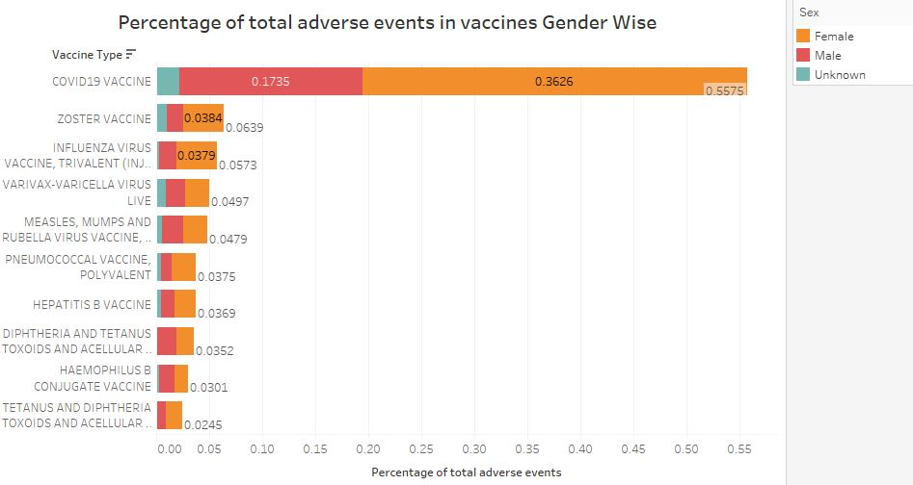
Percentage of adverse events in vaccines gender wise
Figure 1
source of data: CDC website: http://wonders.cdc.gov/vaers.html

Slide 49
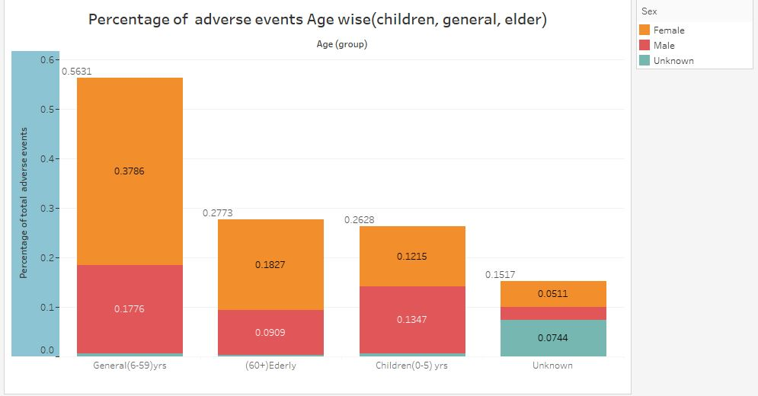
Percent adverse event age-wise
Figure 2
source of data: CDC website: http://wonders.cdc.gov/vaers.html

Slide 50
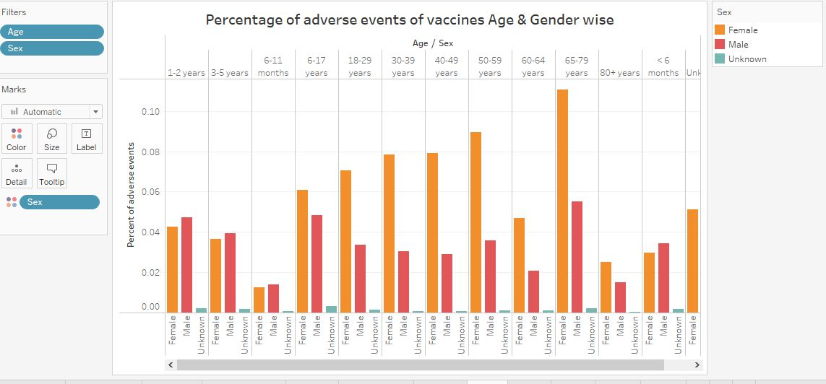
Age and gender-wise adverse events
Figure 3
source of data: CDC website: http://wonders.cdc.gov/vaers.html

Slide 51
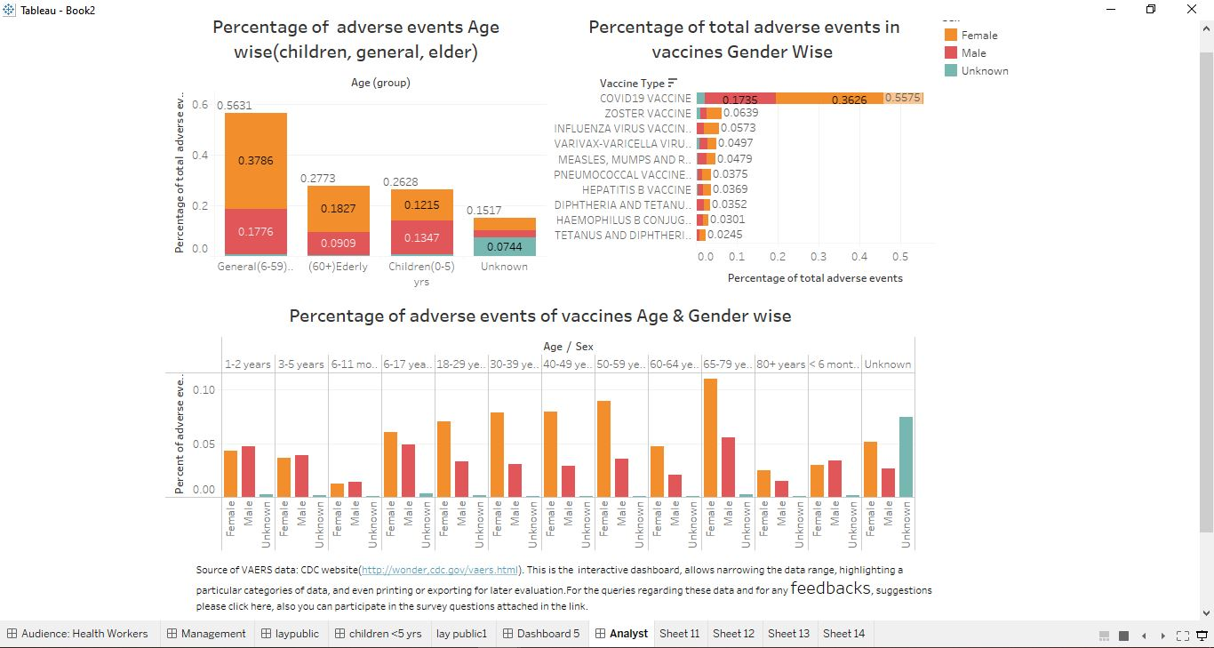
Dashboard presentation for analyst
Source of data: CDC website: http://wonders.cdc.gov/vaers.html The interactive Feedback section is present at the bottom of the dashboard for Analysts.

Slide 52
Results
Figure 1 shows the top 10 vaccines with more adverse events in descending order. The chart also describes the gender-wise distribution of each vaccine with adverse events.
Figure 2 shows the total percentage of adverse events of vaccines age-wise- children(0-5yrs), general(6-59) & elderly(60+).
Figure 3 shows the distribution of the adverse events by age and gender-wise.

Slide 53
Conclusion
The VAERS data from CDC provides a huge dataset about the different lists of vaccines and their adverse events(symptoms). Even though the VAERS raw dataset contains errors, some useful valuable insights were seen after analyzing the data through different visualizations. The visualizations were created for the adverse events reported for the list of vaccines and their relationship with age and gender. These visualizations have provided opportunities for other analysts to do more research and find hidden insights from the provided data.

Slide 54
Feedbacks
For getting feedback, different approaches were used for different audiences:
For Analysts: and Healthcare workers: Tableau is used as an interactive interface for exchanging feedback. Direct questions (about what they heard or the message they received from the presentation )were asked in SurveyMonkey. Any good suggestions should be incorporated in the visualizations and later presentation should be modified as per needs.
https://www.surveymonkey.com/r/3YMRKSP
For Management: Feedback mechanisms were included in the form of emails where questionnaires were asked and they could respond when they are free from their work. It will be easy and effective.
https://www.surveymonkey.com/r/3YMRKSP
For the lay public:
Paper survey- Questions were distributed on the piece of paper, by asking specific questions about the presentation itself. The answer will help us to understand the audience’s comprehension and retention of the presentation. For the educated lay people same questions were asked in SurveyMonkey too.
By interacting directly with the lay audience about the key message and about the visualization
https://www.surveymonkey.com/r/H5YV9FJ

Slide 55
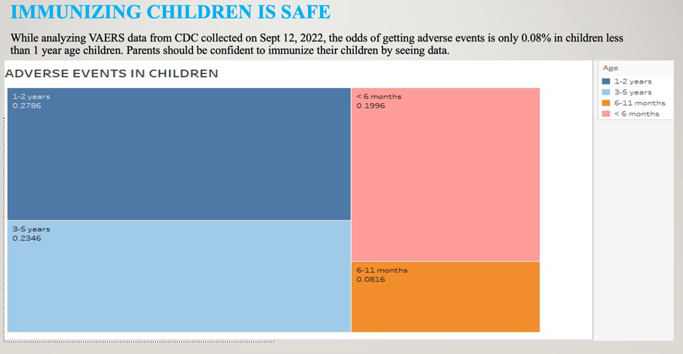
Feedback 1
Is the visualization clear?
Source of data: CDC website: http://wonders.cdc.gov/vaers.html

Slide 56
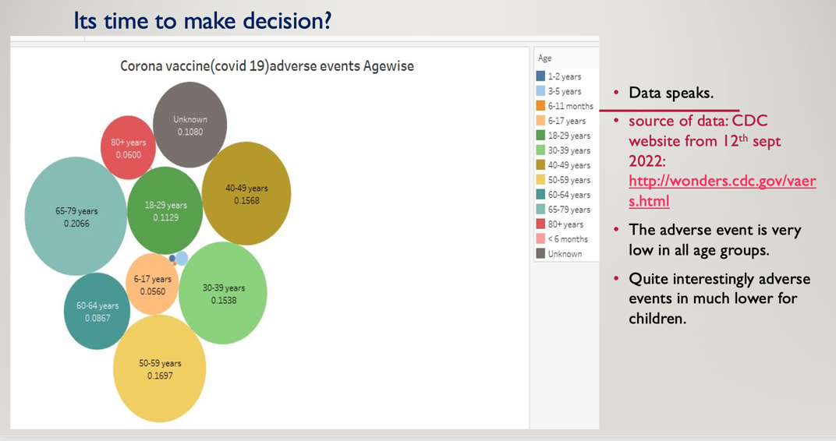
Feedback 2
Is the bubbles size appropriate ?

Slide 57
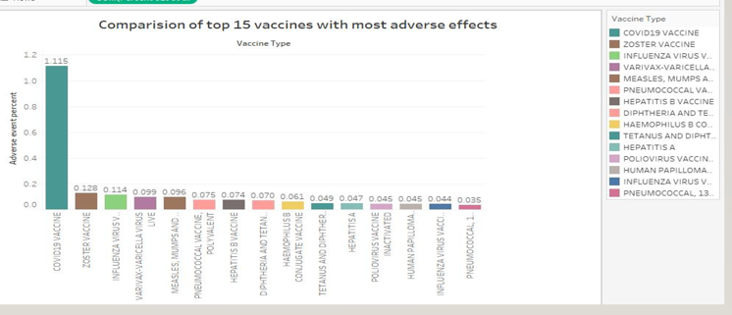
Feedback 3
Is the horizontal bar chart appropriate ?

Slide 58
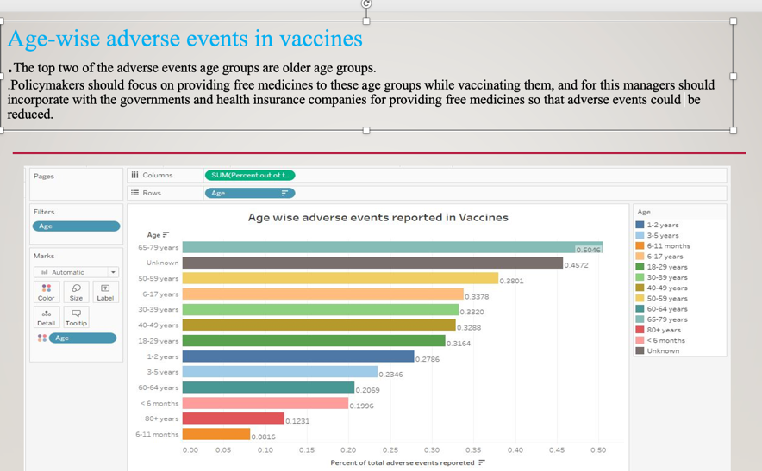
Feedback 4
Is pie chart better for this visualization ?

Slide 59
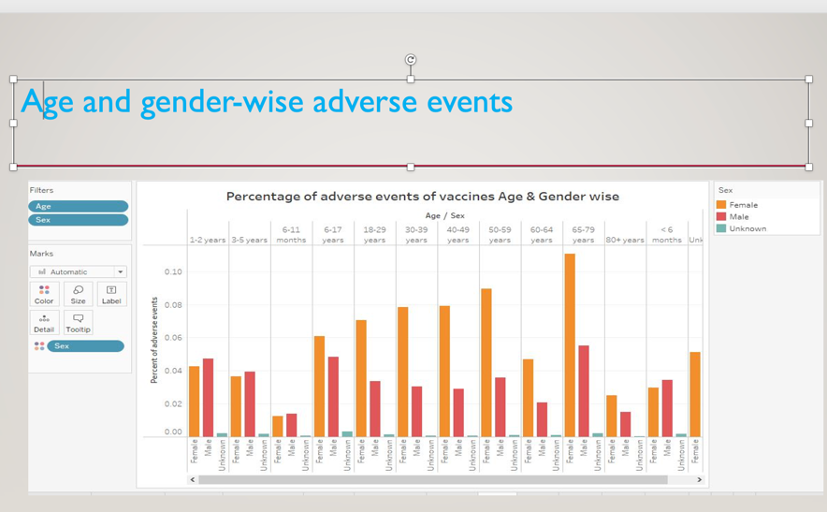
Feedback 5
Is using unknown sex appropriate for visualization?

Slide 60
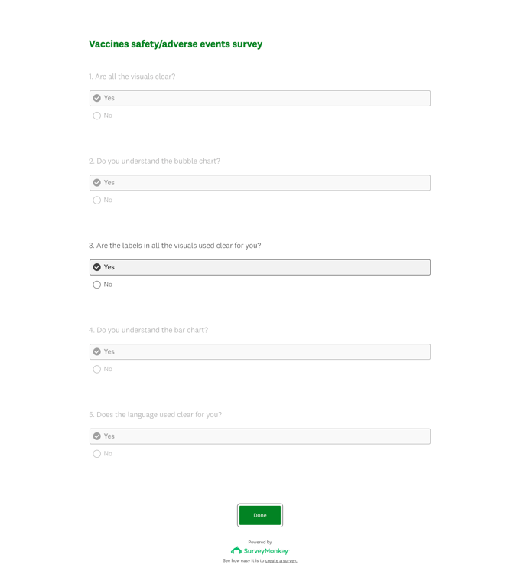
Feedback 6
The question about visualizations itself was asked to know whether they understand the visualizations or not.
Surveys were conducted both as SurveyMonkey or general paper surveys, distributing questions on the paper to the lay public.

Slide 61
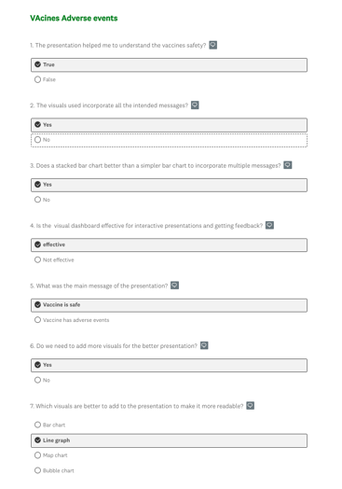
FEEDBACK 7

